Slide 1

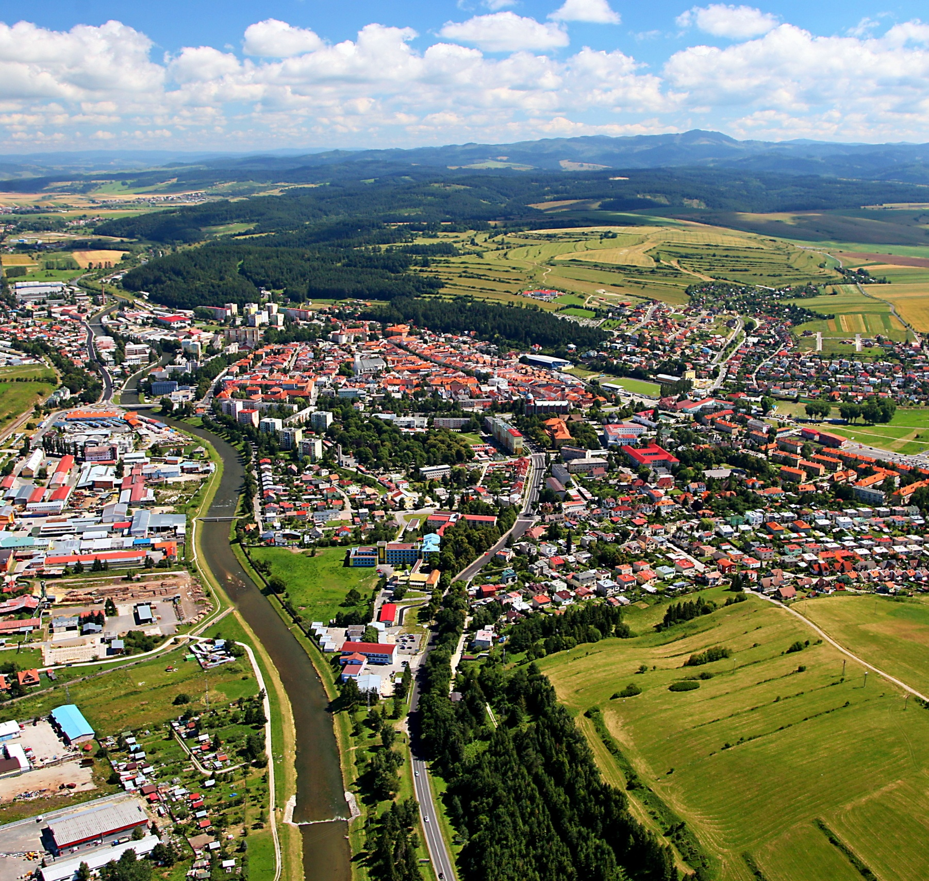


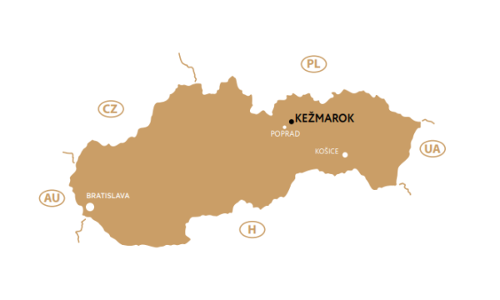

Slide 2






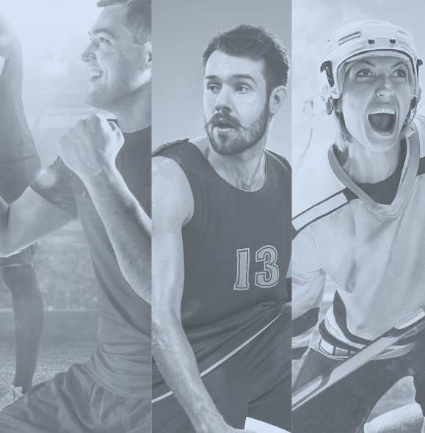


About our town
Kežmarok European Town of Sport 2022
SENIOR FRIENDLY
2016 - 2017
2019
2019
2022
The first mention of the town
dates back to the year 1251.
In 1511, the first sports association,
a shooting club, was founded in Kežmarok.
In 2021, sport is an integral
part of the life of the town.
Notes:
Dear Dear Honorable Guests,
The motto “a healthy spirit in a healthy body” has been living in the historic, modern and dynamic town of Kežmarok for more than 500 years. The first mention of the town dates back to the year 1251. Today it covers an area of 24.83 km². It has more than 16 thousand inhabitants and is one of the first listed towns in Slovakia. Kežmarok is located in the northeast of Slovakia in Prešov Region and is surrounded by several mountains: The High Tatras and Kežmarok Uplands in the west and Levoča Hills in the east. The first sports association, a shooting club, was founded here in 1511. In the 19th century, other clubs and associations continued in the tradition, enlivened and stimulated sports life in the town. The real boom in sport in the modern sense came after World War I. Mainly football in its mass character played an important role in the social life of the town. After 1918, sports clubs and associations covered a much wider range of individual types of sports. Besides football, they focused on athletics, gymnastics, handball, skiing and ice hockey. Nowadays we understand sport as an integral part of the life of the town and its citizens with regard to its educational, social and cultural function.
Now, I will show you my presentation about Intergenrational Sport Values and Active aging: Promoting Healthy Lifestyles.

Slide 3
Kežmarok
European Town of Sport 2022
Intergenerational Sport Values and Active aging: Promoting Healthy Lifestyles.
Apart from athletes, around 30% of all residents
in the town are active in recreational sports.
Kežmarok provides conditions
for competitive and recreational
sports programmes within 25 sports.
The Leisure Time Centre runs 33 out
of school sports clubs, in which 437 children actively participate.
Notes:
When talking about the support of sport, we mean the promotion of physical activities of all age groups within recreational, performance and professional or high performance sport. Apart from registered athletes, around 30% of all residents in the town are active in recreational sports. Kežmarok provides conditions for competitive and recreational sports programmes within 25 sports. Particular attention is put to the preparation of athletes from a very early age.
Sport has an important place in the programmes of kindergartens and primary schools. It allows children to become fit, adopt healthy habits, build healthy self-esteem and find new friends. Primary schools are equipped with modern sports facilities. Physical education in primary schools is seen as a significant part of the educational process, one of the forms of sport, and as a systematic intentional process of transfer, acquisition and further development of sports values.
Besides sports at schools and sports facilities, the town of Kežmarok supports sports activities of children and youth through Leisure Time Centre (CVČ) by realizing, conducting and co-financing school sports competitions on a regional level. The Leisure Time Centre runs 33 out of school sports clubs, in which 437 children actively participate.

Slide 4
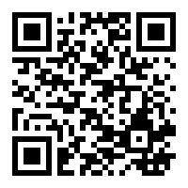
Kežmarok
European Town of Sport 2022
more informations:
www.kezmarok.sk/townofsport
Intergenerational Sport Values and Active aging: Promoting Healthy Lifestyles.
Notes:
Thank you for your time and attention!

Slide 5
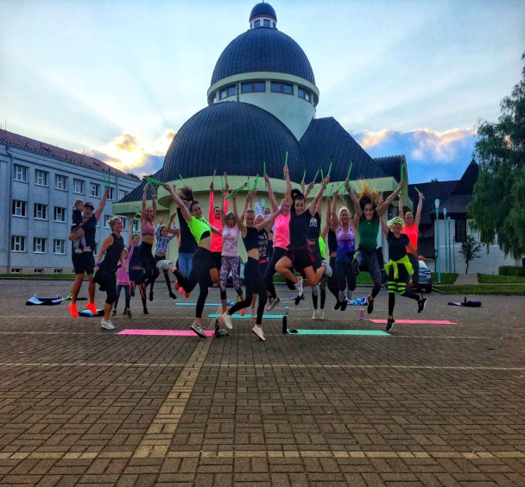
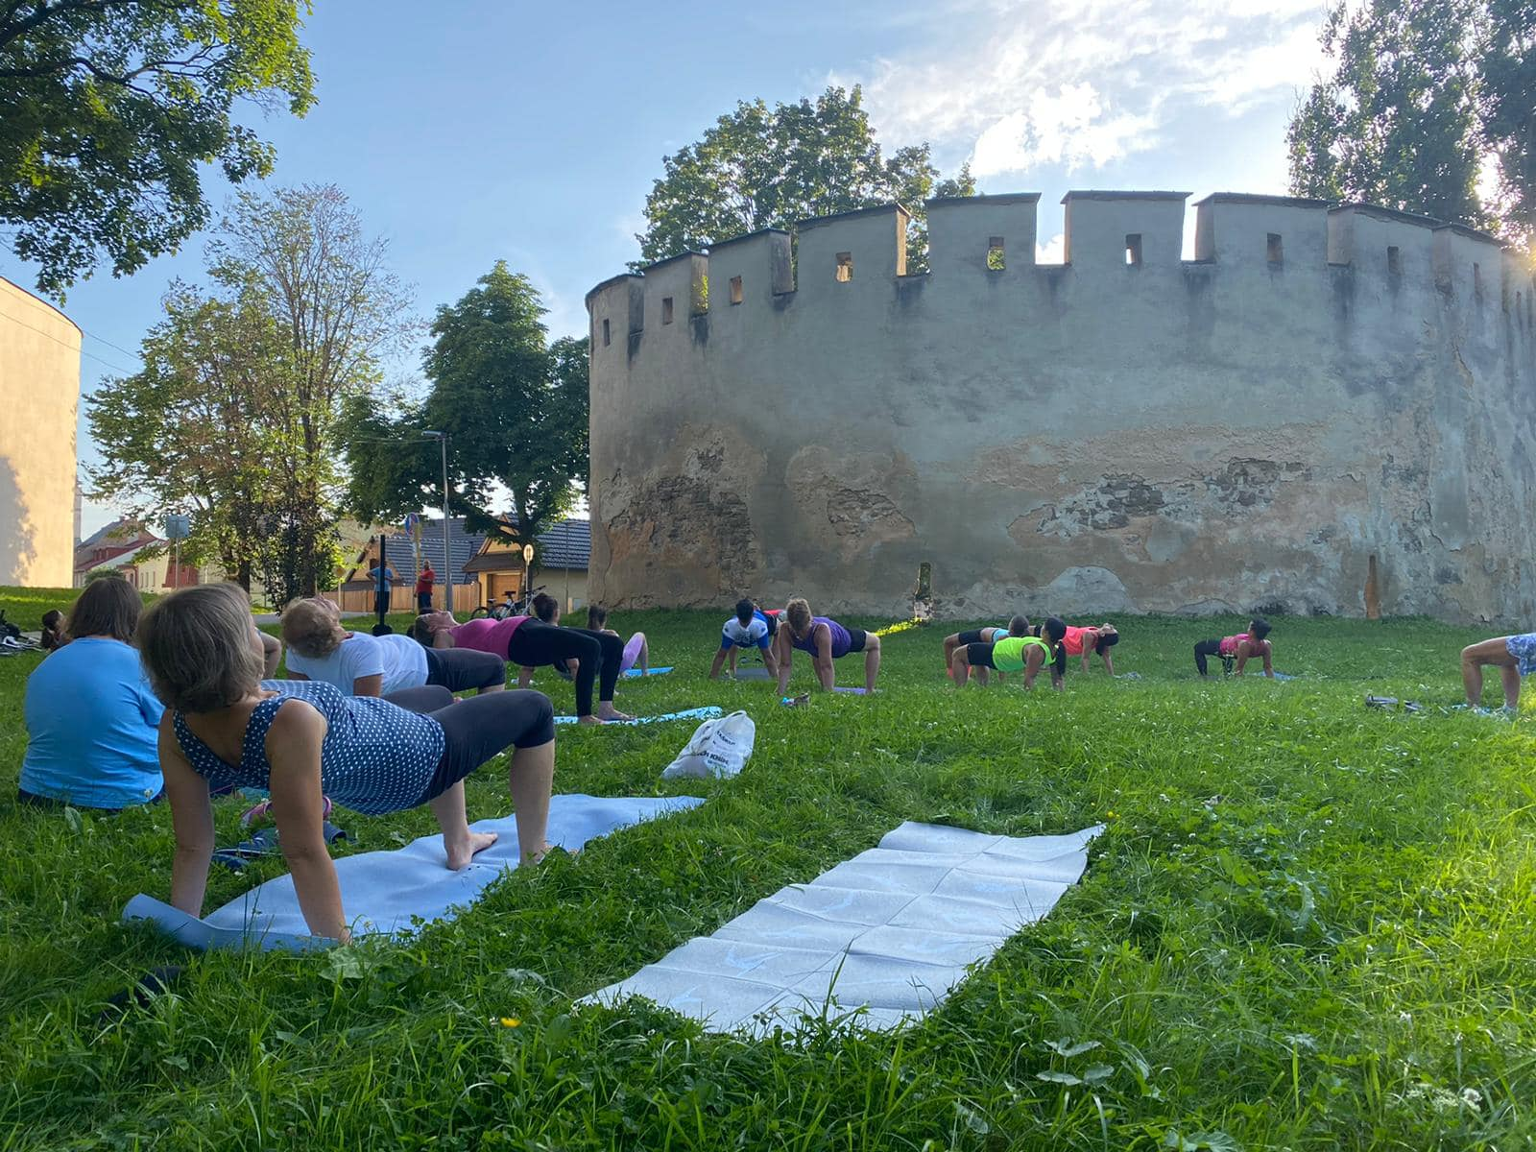

Slide 6
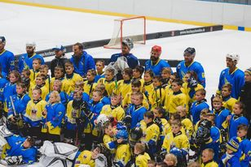
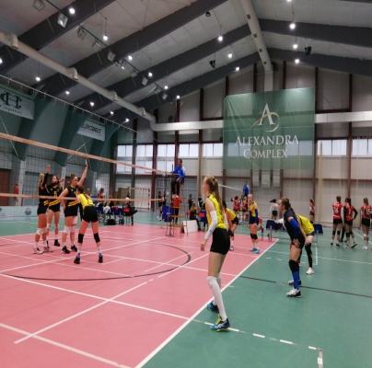
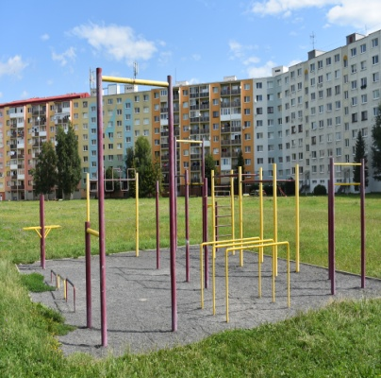
Kežmarok
European Town of Sport 2022
Diversification of sports offer during large grassroots sport events – good practises
Every summer, the town of Kežmarok,
in cooperation with sports clubs,
organises 13 sports events called Kežmarok Sports Days.
In the Winter National Games more than 160 athletes with intellectual disabilities participate.
Every June, Children’s Paralympics is held for physically handicapped children and children with other disabilities from Kežmarok district.
Notes:
Sport as a social phenomenon and the town as a centre of social life are very closely interrelated. Every summer, the town of Kežmarok, in cooperation with sports clubs, organises 13 sports events under the name Kežmarok Sports Days. They are organized under the auspices of sports clubs; however, they are open to the general public. These events include basketball, volleyball, cycling races for children and youth, tournaments in table tennis, football, tennis, chess and others. Moreover, all sports enthusiasts can join the run through the town or participate in summer outdoor exercises in various localities of the town of Kežmarok, under the guidance of experienced instructors. The town of Kežmarok is located below the beautiful High Tatra Mountains, which are popular with tourists, skiers, mountain climbers and visitors to our region. Thanks to their close distance and wide range of hiking possibilities, the Slovak Tourist Club organizes trips for club members and the general public. The promotion of sport for the disabled in the town of Kežmarok is carried out through cooperation with organisations, sports clubs and school facilities in order to achieve the highest possible integrity of the town's citizens in social life. The Archery Sports Club has been covering all categories of physically disabled athletes for 20 years. The club´s president Mr Vladimír Majerčák, who himself is a disabled athlete, is a multiple medal winner from the Paralympics and World, European and Slovak championships. Under his leadership, Slovak and Kežmarok physically impaired archers have been achieving good results in this discipline for a long time. The cooperation of the town of Kežmarok with the Special Olympics Slovakia has resulted in the organization of the Winter National Games, in which more than 160 athletes with intellectual disabilities participate. Other events held to promote sports for disabled citizens are the Children´s Paralympics, hippotherapy, which uses horseback riding for healing, or a sports day organized by the Senior Citizens´ Centre, in which both the healthy and the disabled compete in a joint inclusion in simple competition disciplines.

Slide 7
Kežmarok
European Town of Sport 2022
more informations:
www.kezmarok.sk/townofsport
Diversification of sports offer during large grassroots sport events – good practises
Notes:
Thank you for your time and attention!

